Slide 1


Slide 2
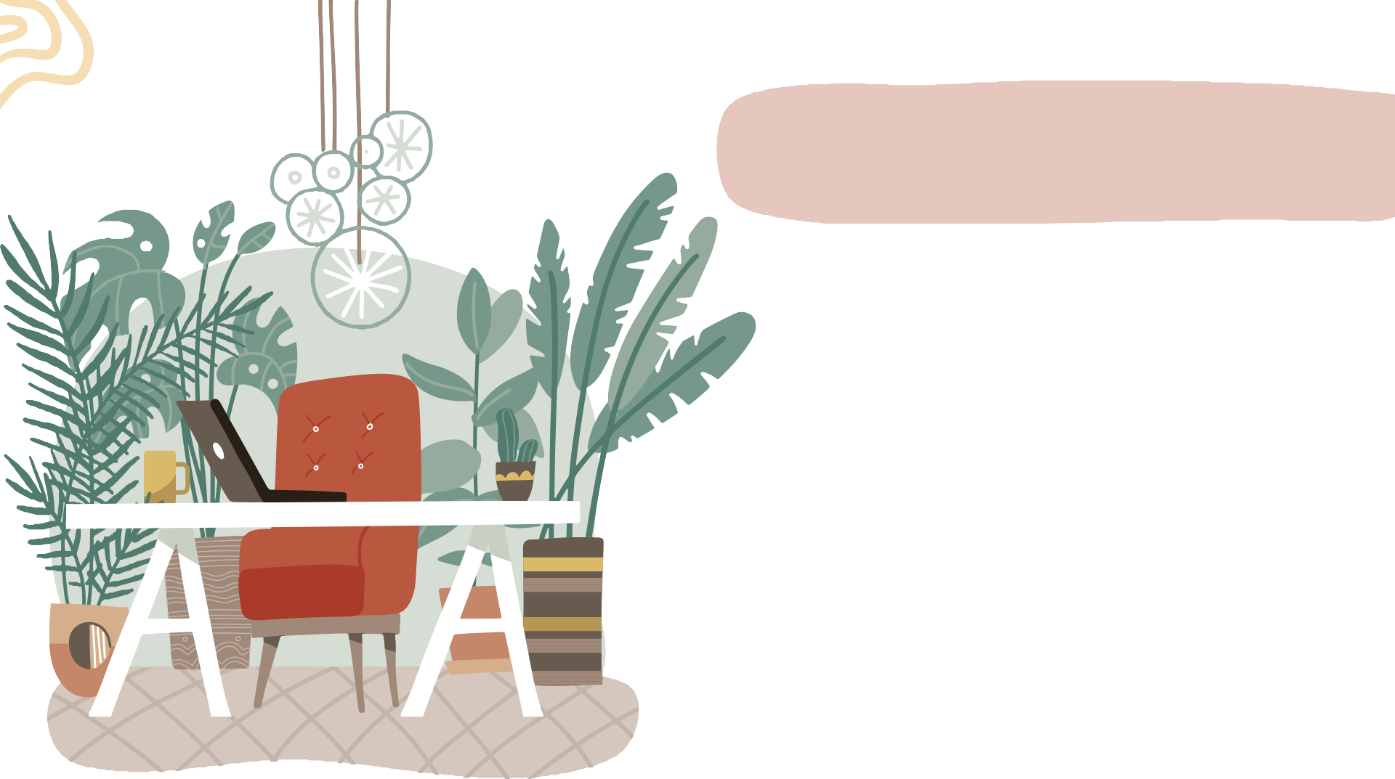
Green House Oasis
Use of Internationally acclaimed Hydro culture technology for plant maintenance which uses no soil for plant growth.
Limited usage of water and sunlight exposure. No need to water everyday.
No mosquito / hygiene concerns
aesthetically pleasing and calming experience for employees which creates positive atmosphere instantly.
Certified technicians for plants maintenance

Slide 3
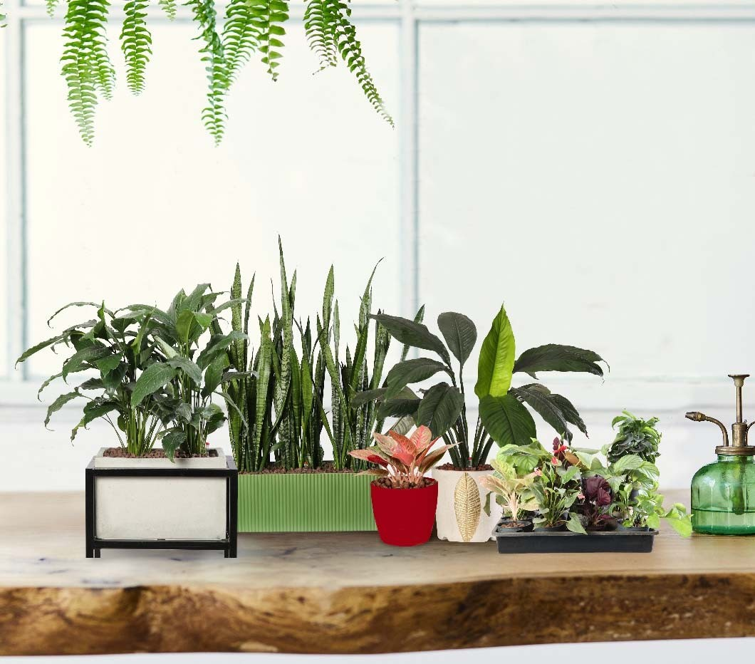
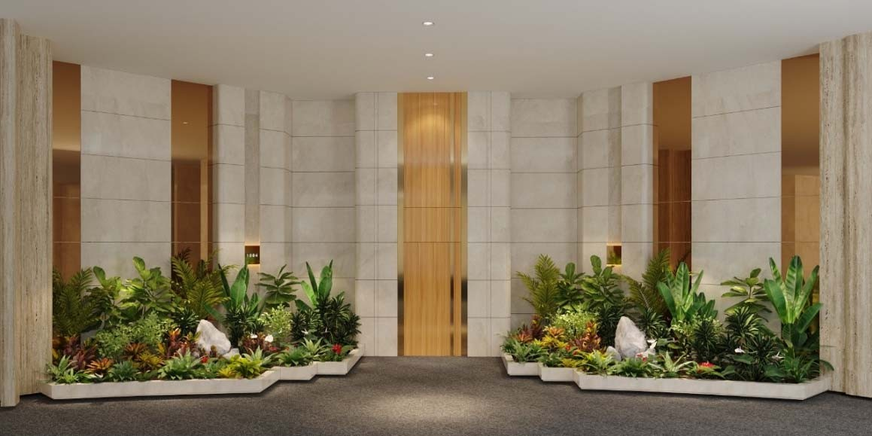
PLANT RENTAL SERVICE
We provide plant rental service across India.
We offer plant rental doorstep service with installation of plants, Maintaining the plants & Replacing the same.
Our team consists of 12+ staff members with more than 10+ year experience.
Gardener have a minimum 5+ year
experience of maintaining the landscape.

Slide 4
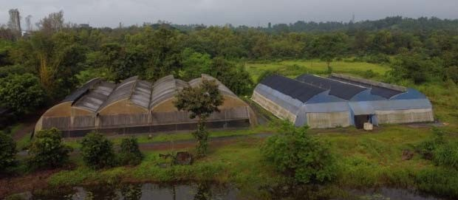
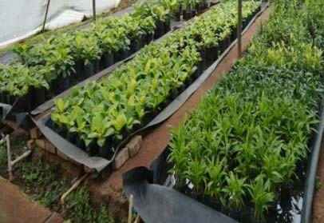
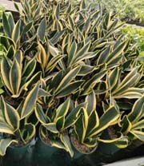
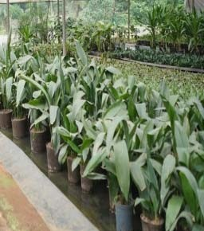
Hydroponic Nursery
Producing hydroculture plants since 2015.
30+ dedicated staff for production and maintaing the plants.
Over a 40 acres of land for production of different Hydrophonic plant species.
Hydrophonic nursery spread across 2 acres.
Production of 50+ different species of plants.
Automated irrigating system.
Different humidity chambers for large scale production. Hydrophonic plants ranging from height of 0.5” to 11’.
We use grow pots, which are imported from Europe with 5+ different sizes.
Grow pot size available- 9/7cm,11/9cm,13/12cm,18/12cm,15/19cm,18/19cm,22/19cm,28
/19cm,32/19cm,32/28cm.
Water indicator size available – 7cm,9cm,19cm,35cm.
Almost all plants are available in a Hydrophonic system. whether
you are looking for a beautiful Palm varieties , Sansevieria, Scindapsus, Mossticks Aglonema varieties, Radermachera, Anthurium, Philodendron, Bonsai or a Dracaena varieties .

Slide 5
DIFFERENCE BETWEEN SOIL PLANTS AND HYDROCULTURE PLANTS
PARTICULARS | Soil Plants | Hydroculture Plants
System | Soil | Hydrophonic
Planting Media | Soil and Cocopet Mix | 100% LECA balls
Weight | Little Heavy because of soil | Light weight
Mortality of Plants | 8 TO 10% Per Month | 2 TO 3% Per Month
Irrigation | Daily or Uneven And Moderate Requirement | Water reservoir, Once in a week, Very Less Requirement
Weeding | Weeding Require | No Weeding
Media Changes | Soil changes and loosing required at least once in a month | No Soil changes/loosing
Cleanliness | Unclean | Clean and odourless
Fertilization | Fertilization require once a month | Slow release fertilizer once in 6 months
Water Requirement | Average - 500 ml/Sq. Ft/ Day | Average - 100 ml/Sq. Ft/ Day
Hygiene | Dirt under nails during installation and replacement | No dirt under nails during installation and replacement
Insects & Diseases | Soil is a host for many pests and diseases that can harm plants. | Eliminates soil borne diseases and pests, mosquitos
Hydroculture System ‐
It is the science of growing plants without soil.
Plants are grown in an Expanded Clay, which is completely natural. Ensure an optimum air/water/fertilizer ration for healthier plants.
Over a 40 acres of land for production of different Hydroponic plant species.

Slide 6
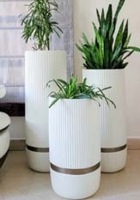
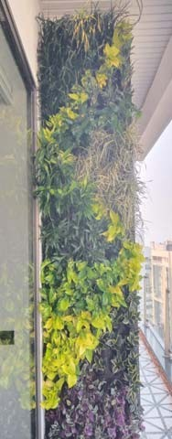
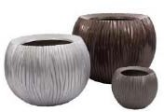
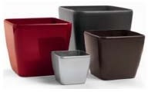
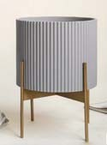
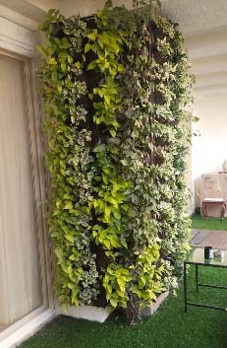
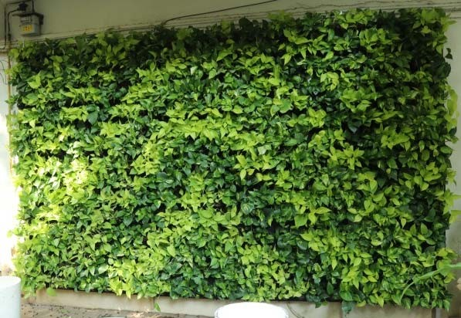
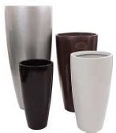
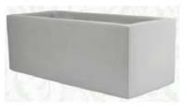
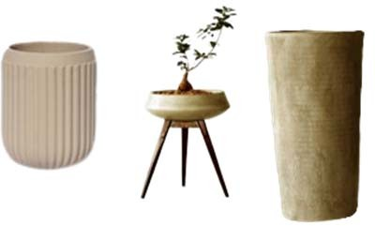
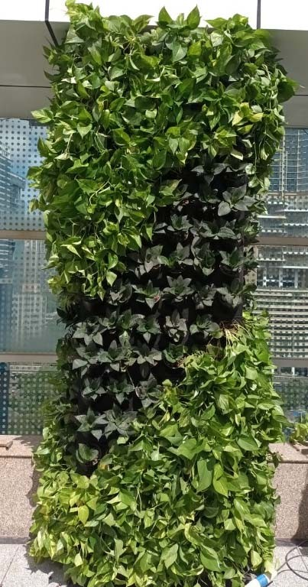



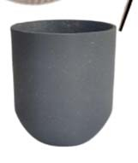
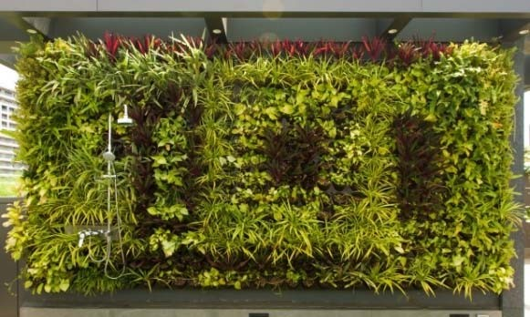
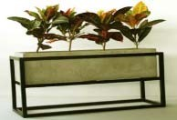
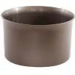



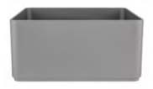
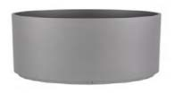
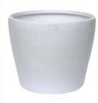
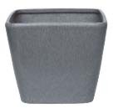
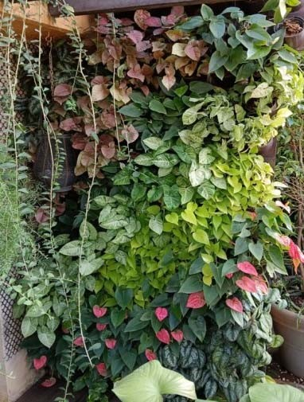
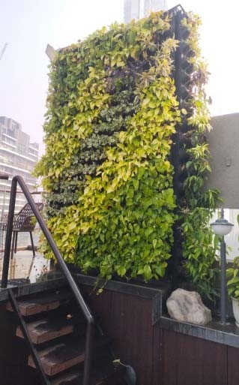
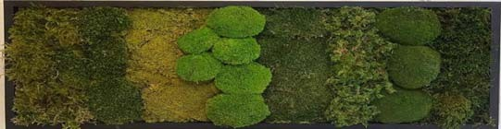
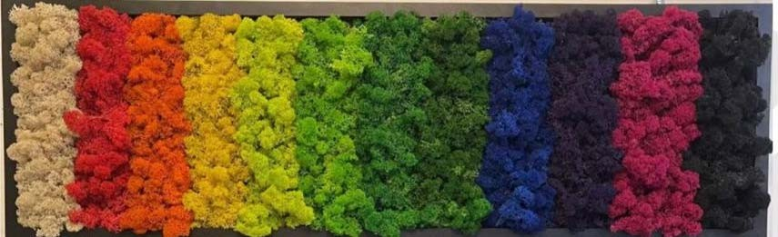
Planters
Vertical Green Wall
Fiber Glass Fluted Planters
Fibre Glass Planters
Plastic Planters
Concrete Planters
Importated Plastic Planters Plastic Roto Moudled
Preserved Moss

Slide 7
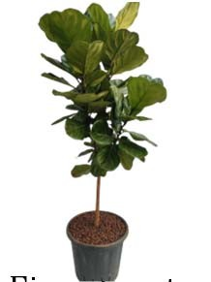
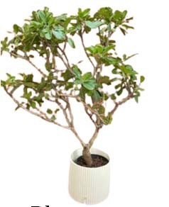
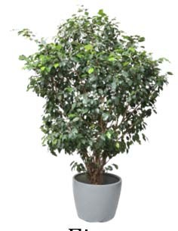
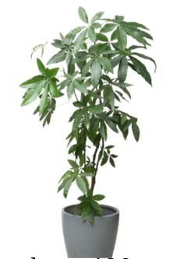
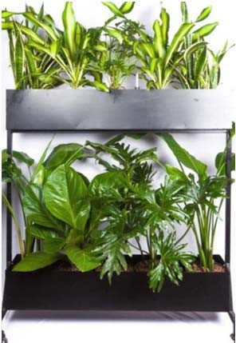
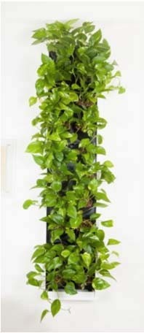
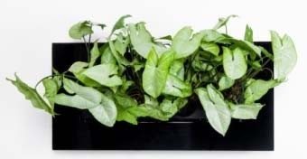
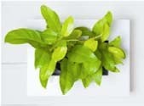
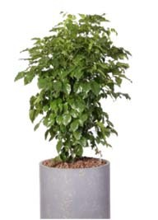
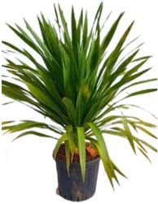
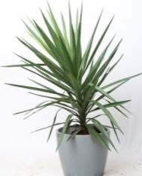
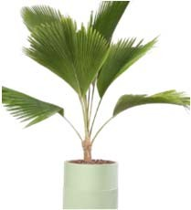
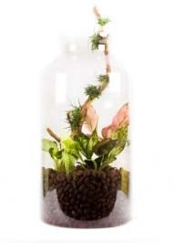
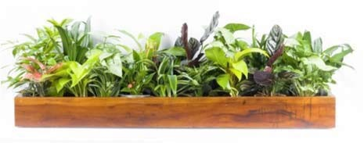
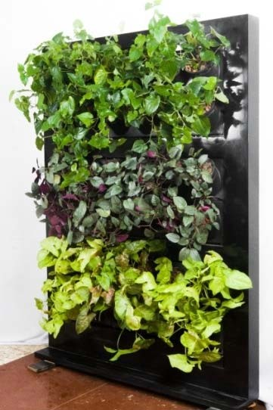
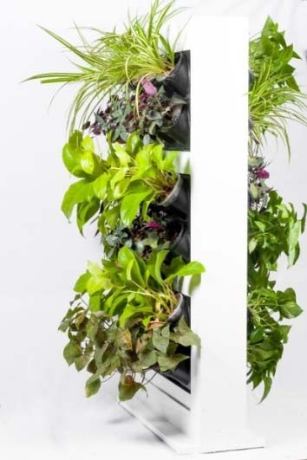
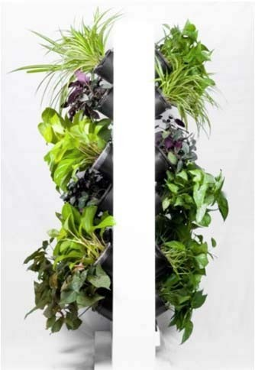
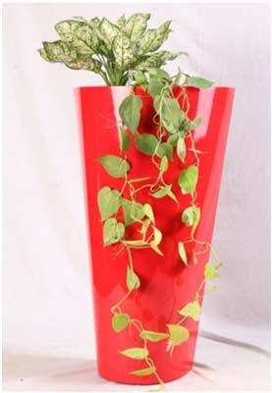
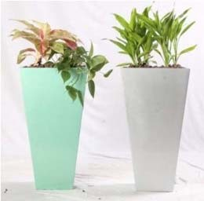
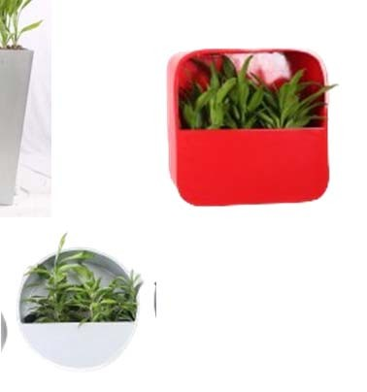


Ficus Lyrata
Plumeria Singapore Dwarf
Ficus Benjamina
Hanging Wall Frame
Pachira / Money Tree
Room Divider (Fabricated)
Radermachera sinica
Dracaena Draco Big Leaf
Yucca Globra
Fan Palm
Hanging Green Wall
Green Furniture
Terrarium
Cabinet Planters
Room Divider Movable - One Side
Room Divider Movable - Two Side
Wall Mounted Planters

Slide 8
































Syngonium Green
Syngonium Pink
Croton petra
Spathiphyllum
Alocasia
Philodendron selloum
Dracaena Big Leaf
Dracaena green
Ficus Elastica Rubber Plant Variegated
Ficus Elastica Rubber Plant Green
Dracaena Dara Singh
Dracaena Vectoria
Zamioculcas/ ZZ Plant
’
Strelitzia - BOP
Aspidistra
Chamaedorea Elegans
Cordyline fruticosa
Schefflera arboricola
Dieffenbachia ‘Seguine’
Dieffenbachia ‘Pinky’
Philodendron monsteraalm
Areca Palm
Rhapis Excelsa
Clusia
Dracaena marginata
Ficus Variegated ’
Philodendron Gold moss stick
Money plant moss stick
Dracaena Draco
Homalemena Green
Dracaena marginata tricolor
Brassia

Slide 9
































Aglaonema Cutlass
Aglaonema Cutlass
Aglaonema ‘Manila Beauty’
Aglaonema Green
Money Plant Green
Calathea ‘Makoyana’
Calathea Wavestar
Calathea Orbifolia
Aglaonema ‘Snow White’
Aglaonema ‘Anjamanee Green
Aglaonema ‘Anjamanee Red
Aglaonema lipstick
Anthurium
Anthurium hookeri
Sansevieria Yellow
Sansevieria Green
Dracaena Surculosa ‘ Florida Beauty
Dracaena Surculosa Milky Way
Dracaena compacta
Philodendron Moon Shine
Philodendron ceylon gold
Philodendron Xanadu
Song of India
Ficus Bonsai
Dracaena Lucky Bamboo
Money Plan Marble Queen’
Golden Money Plant’
Money Plant N- Joy
Philodendron melinoniii gold
Philodendron congo
Bird nest fern
Aralia

Slide 10


CONTACT US
+91- 9167051020
www.officemadari.com roshan.sequiera@officemadari.com
101/ A wing, Sheeba Apt.,Andheri (E) Mumbai, -99

Slide 11

THANK YOU
We appreciate the opportunity to share our expertise and offerings with you. Whether it's enhancing workplace environments, managing events seamlessly, or ensuring sustainable practices, we're committed to supporting your corporate goals. Contact us today to begin a partnership that elevates your business environment and employee experience.
All Rights Reserved | Copyright © 2024 Office Madari
Conceptualized & Designed by DIGINEXA

